Slide 1
Access to healthcare in rural Ethiopia
Student ID: 670000131

Slide 2
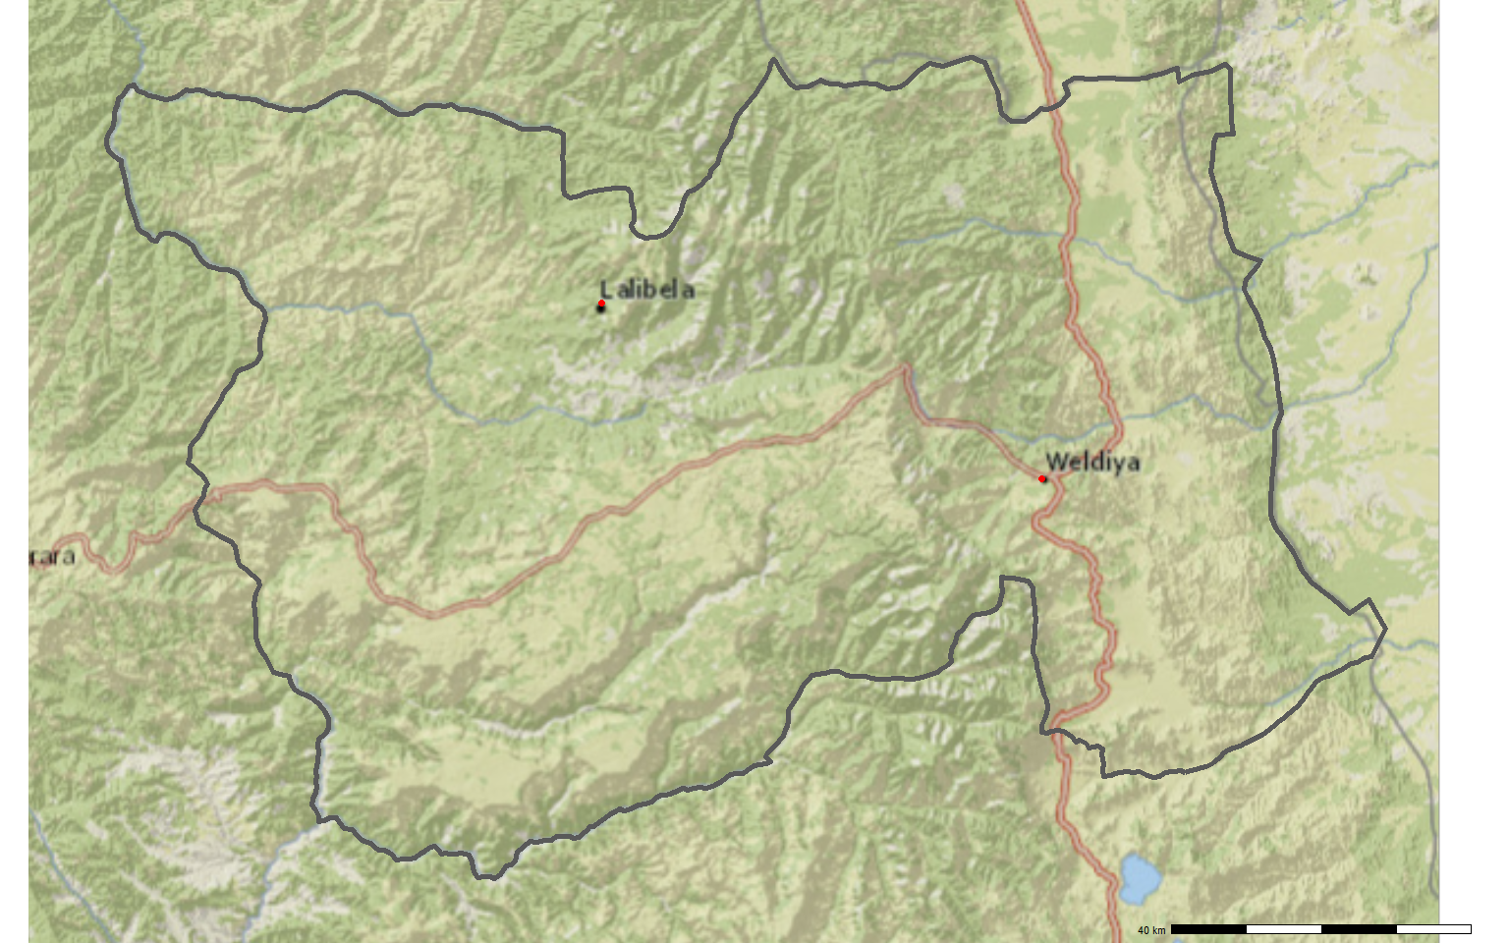
Background

Slide 3
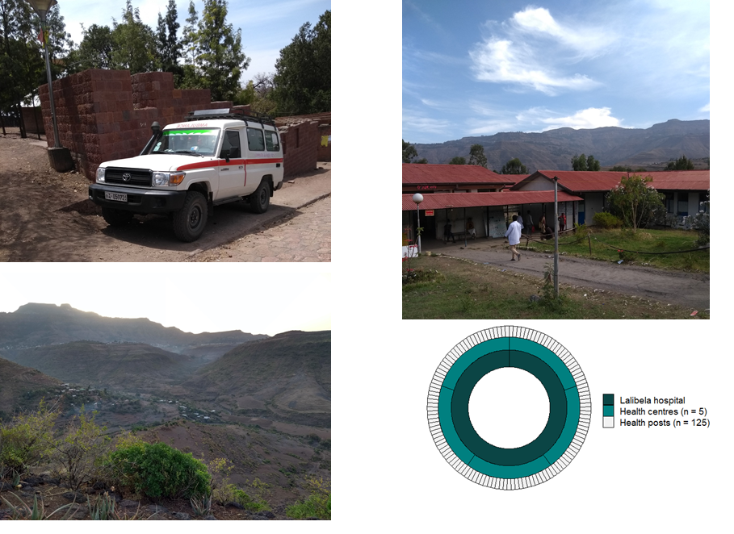

Slide 4
Aim
To evaluate the accessibility of health care facilities in North Wollo district
Calculate travel times to health care facilities
Compare travel times to spatial population density

Slide 5
Methods
World Health Organisation geo-referenced list of healthcare facilities
Population density estimates from World Population database
Travel times to health facilities using Open Source Routing Machine
Overlay travel times and population density to visualise areas with poor access
All analysis done with R statistical software (Version 4.0)

Slide 6
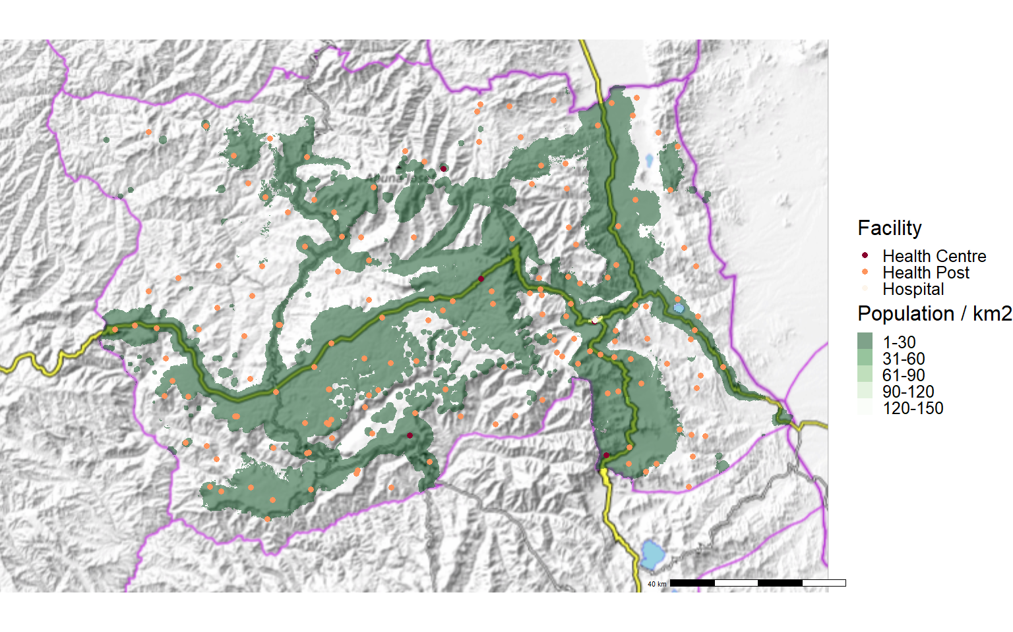
Results

Slide 7
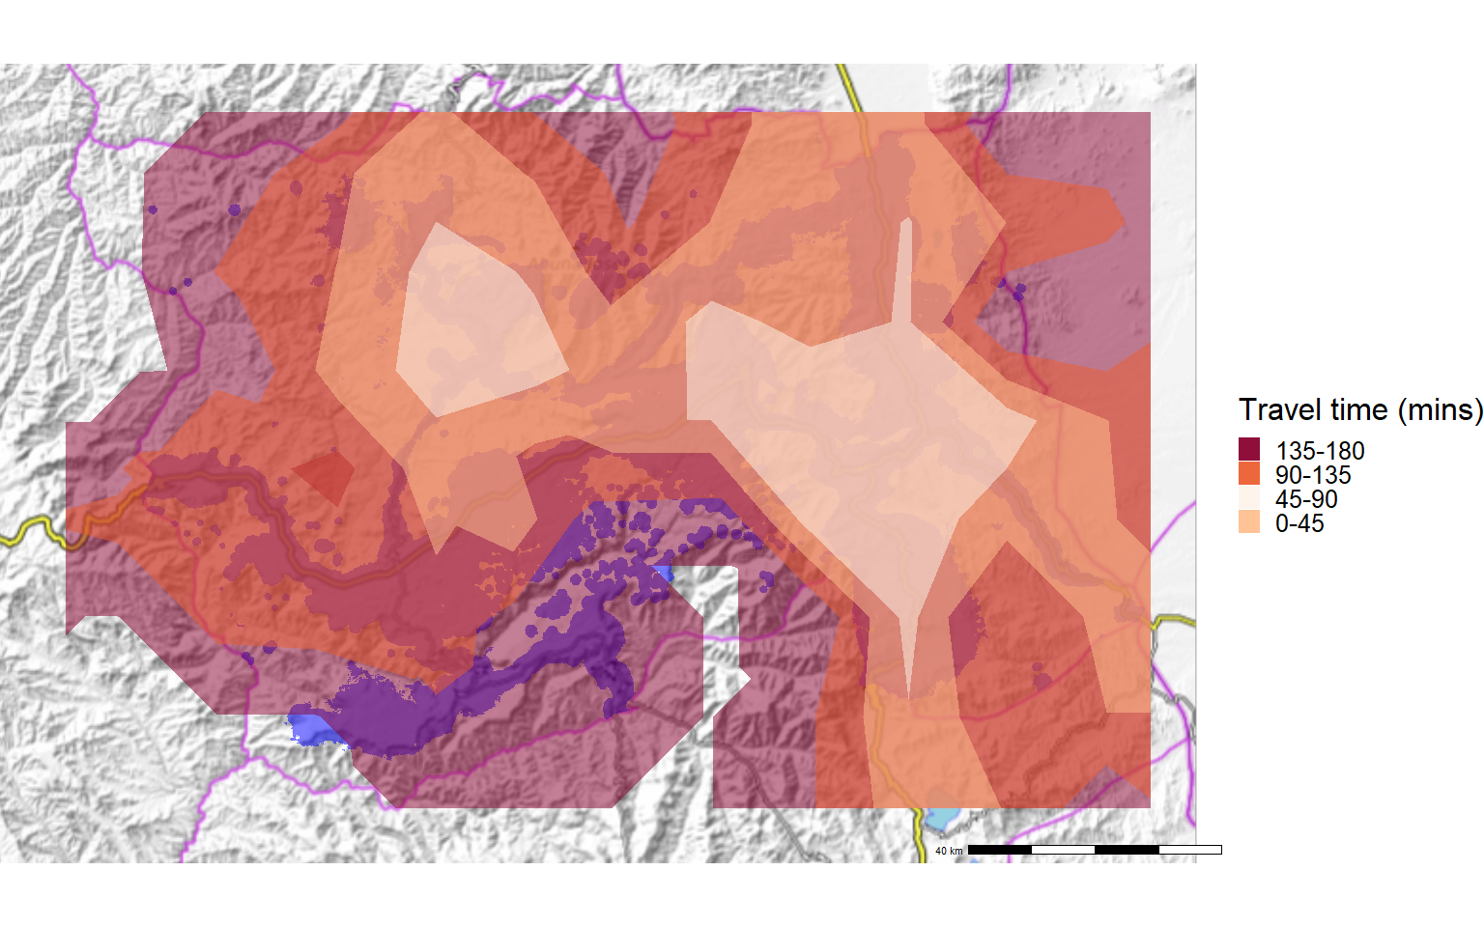

Slide 8
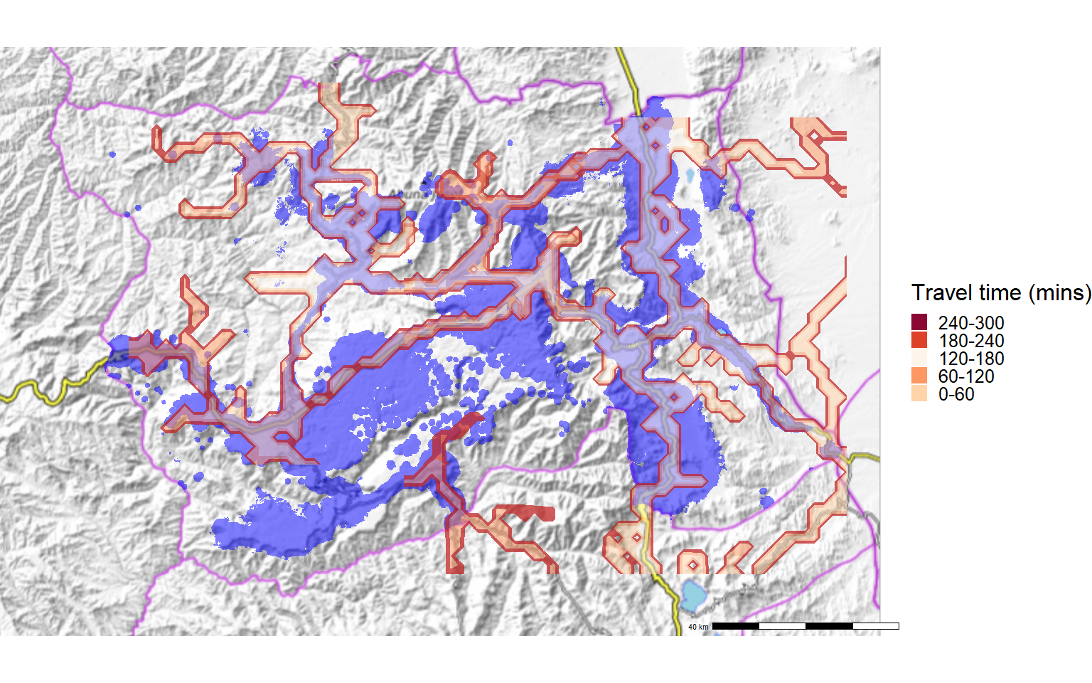

Slide 9
Discussion
Limitations
Walking paths
Rainy season
Accuracy of locations
Identify locations that need better access
Planning new infrastructure
Mobile clinics
Further studies
Surveys of access and health care utilisation
Capture re-capture studies for accuracy of locations

Slide 10
References

